Slide 1
1. Main Problems
Revenue Issue
Decreasing CBV at Go-Shop, Go-Food, Go-Mart.
Operational Issue
Decreasing #Completed Order at Go-Ride, Go-Send, Go-Box, Go-Massage, Go-Clean, Go-Tix.

Slide 2
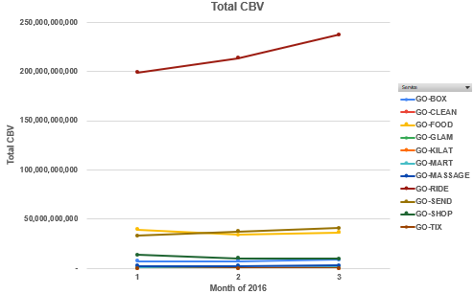
Revenue Issue
Decreasing Trend of % CBV growth (from Jan 2016 to March 2016) 1. Go-Shop by -29.14% or -4 billions (Rp). 2. Go-Food by -7.13% or -2.8 billions (Rp). 3. Go-Mart by -13.74% or -139 millions (Rp).

Slide 3
Operational Issue
Priority | Descriptions | Products
P1 | % MoM decreasing of completed order > 10% | Go-Tix
P2 | % MoM decreasing of completed order between 5%-10% | Go-Kilat, Go-Clean
P3 | % MoM decreasing of completed order between 1%-4% | Go-Ride, Go-Send, Go-Massage, Go-Box

Slide 4
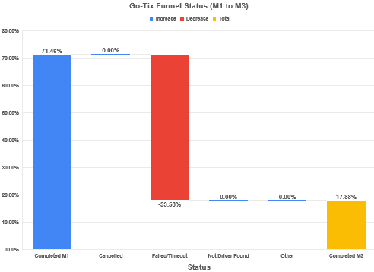
Operational Issue ~ P1
Decreasing completed order in Go-Tix caused by failed/timeout ~ bugs in system.

Slide 5
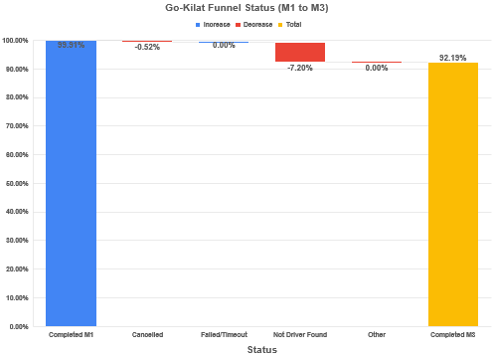
Operational Issue ~ P2
7.72% Decreasing completed order in Go-Kilat caused by cancelled order and not driver found.

Slide 6
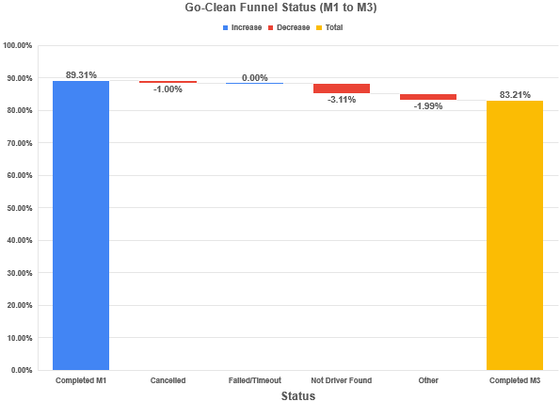
Operational Issue ~ P2
6.1% Decreasing completed order in Go-Clean caused by cancelled order, Not driver found, and other reasons

Slide 7
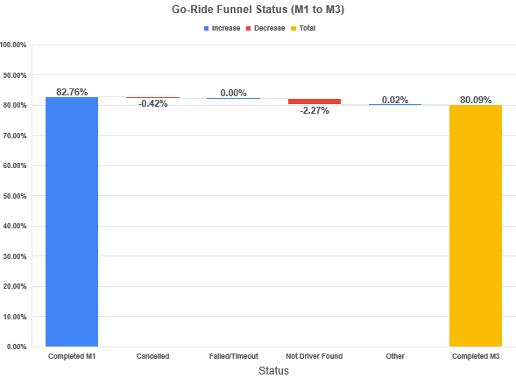
Operational Issue ~ P3
2.67% Decreasing completed order in Go-Ride caused by cancelled order and Not driver found.

Slide 8
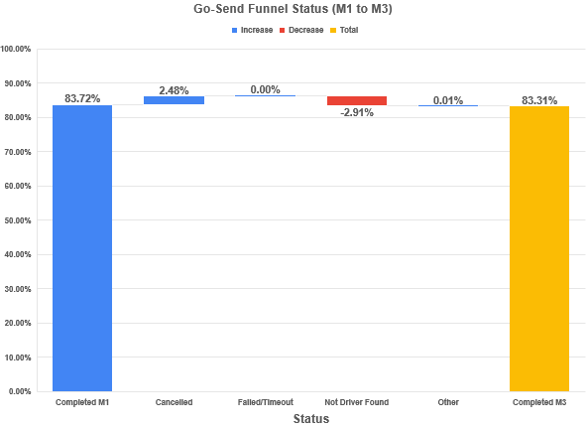
Operational Issue ~ P3
0.41% Decreasing completed order in Go-Send caused by Not driver found.

Slide 9
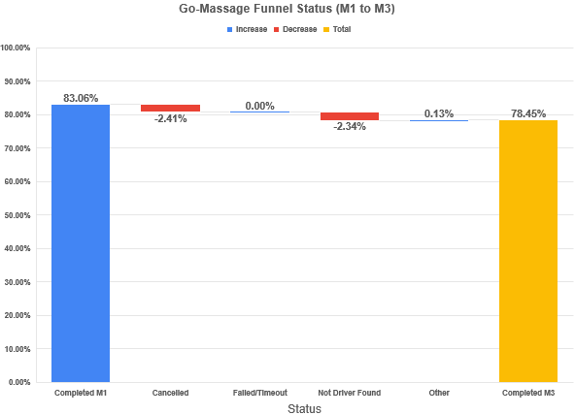
Operational Issue ~ P3
4.61% Decreasing completed order in Go-Massage caused by cancelled order and Not driver found.

Slide 10
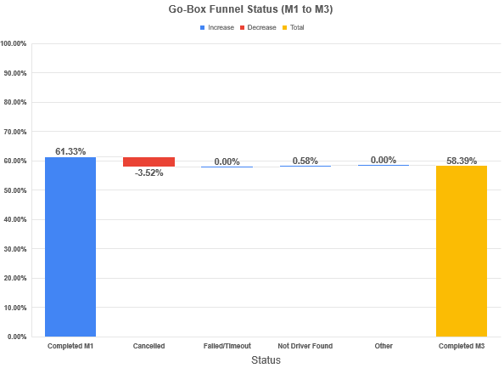
Operational Issue ~ P3
2.94% Decreasing completed order in Go-Box caused by cancelled order.

Slide 11
Revenue x Operational Sector
Decreasing Revenue From Jan 2016 to March 2016 at Go-Shop, Go-Food, and Go-Mart not caused by internal factor ~ operational issue. These 3 products showing increment completed order.
This decreasing could be caused by external factor ~ our competitors (Grab).
No. | Products | % Increment Completed order (Jan to Mar 2016)
1. | Go-Shop | + 12.51%
2. | Go-Food | + 14.65%
3. | Go-Mart | + 17.41%

Slide 12
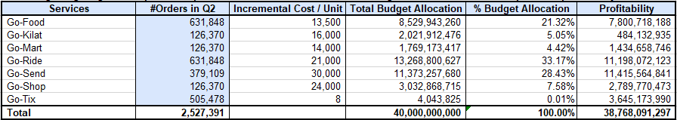
2. Optimize Profitability with 40 billions budget.
Excluding Budgeting for Non profitable product ~ Go-Clean, Go-Glam, Go-Massage, Go-Box to reach max potential profitability.
TOP 3 budget allocation will be focused on most profitable products
Go-Ride ~ 33.17% of total allocation / 13.2 billions (Rp).
Go-Send~ 28.43% of total allocation / 11.4 billions (Rp).
Go-Food~ 21.32% of total allocation / 8.5 billions (Rp).
With this budgeting allocation, can only add 38.8 billions (Rp) to profitability from inorganic channel.

Slide 13
Next Step
Check with market research team for Go-Shop, Go-Food, Go-Mart decreasing revenue case for competitors analysis. (Can trigger with more interesting promos if needed).
Fix P1 & P2 operational issue for Go-Tix, Go-Kilat, and Go-Clean products.
Reducing budgeting because of the not significant impact to our profitability.

